Slide 1
GRAPH

Slide 2
INTRODUCTION
A data structure that establishes a relationship from many parents to many children is graph.
In real life its used in number of situations like modelling the interonnection between various cities,airmap modelling the interconnection between various countries,
routing messages over a computer network from one node to another,flow chart of a program.

Slide 3
Defination:
A graph is a non-linear data structure that consists of a collection of nodes(or vertices) and a collection of edges,with each edge joining one node to another.Edges are sometimes referred to as arcs.Formally a graph G=(V,E) consist of two sets
(a) V called set of vertices or nodes.
(b) E called set of all edges or arcs.This set E is the set of pair of elements from V.If there is an edge connecting nodes v1 and v2 then it is represented as(v1,v2) where v1,v2 ɛV
In graph,vertices ae represented by circles or points and edges as line segments or arcs connecting the vertices.

Slide 4
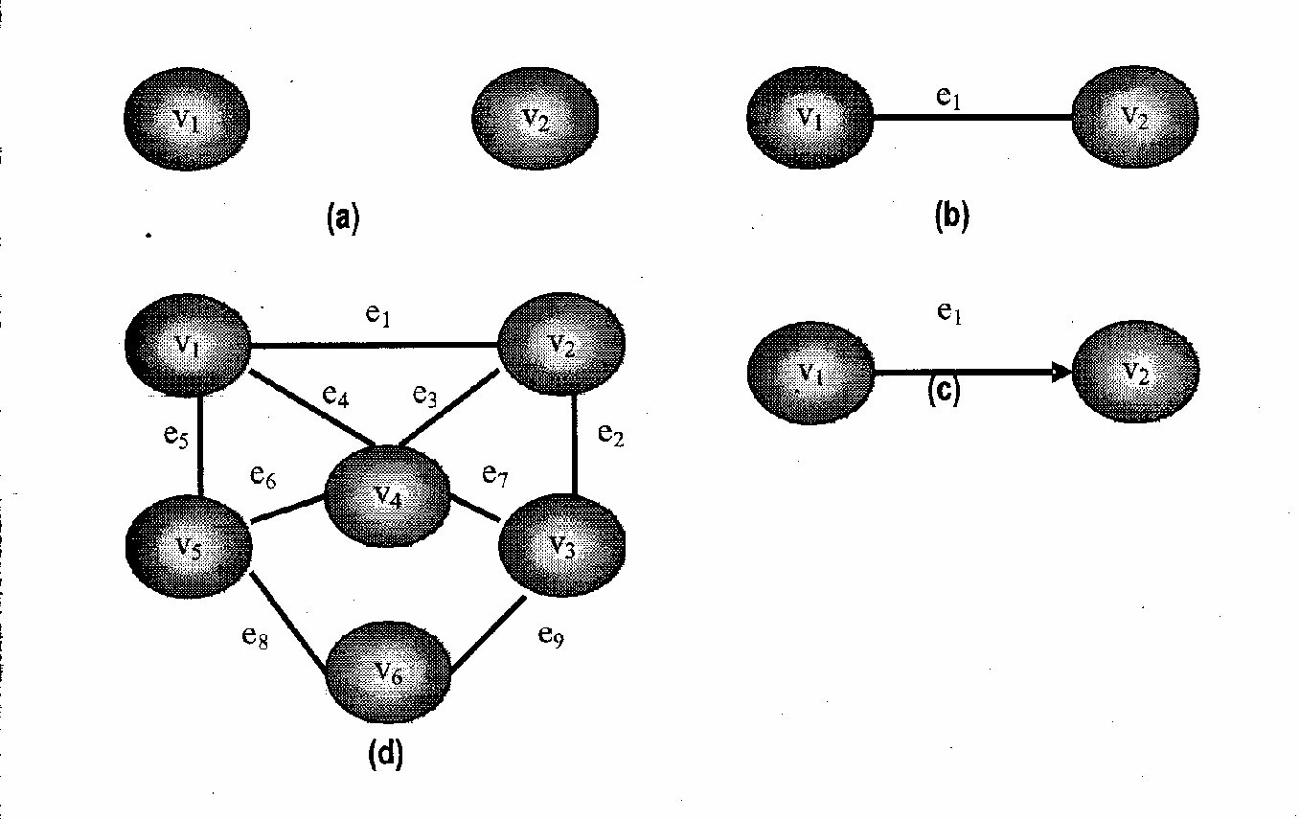
www.csemcq.com

Slide 5
The edge in a graph can be directed or undirected depending on whether the direction of the edge is specified or not.
A graph in which each edge is directed is called a directed graph or digraph.
A graph in which each edge is undirected is called undirected graph.

Slide 6
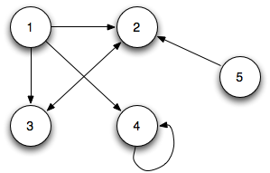
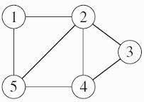
DIRECTED GRAPH
UNDIRECTED GRAPH

Slide 7
GRAPH TERMINOLOGY
1.ADJACENT VERTEX:
Two vertices in a graph are said to be adjacent if there exsists an edge between them.if a graph contains an edge(v1,v2) then vertex v2 is said to be adjancent to vertex v1.

Slide 8
2.PATH:
A path is a sequence of vertices traversed by following the edges between them.A path is simple if it has no repeating vertices
One special type of simple path is called cycle. A cycle is a simple path consisting of sequence of vertices such that the starting and ending vertex are same.
A loop is special case of cycle in which an edge begins and ends with the same vertex.
If a graph doesnot contain any cycle then it is called an acyclic graph.

Slide 9
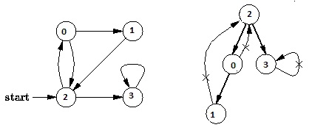
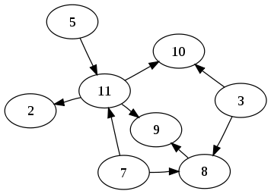
ACYCLIC GRAPH
CYCLIC GRAPH

Slide 10
3.DEGREE OF VERTEX:
In an undirected graph ,the degree of vertex is the number of edges originating from it.
In other words,the number of edges connected with vertex v_{i} is called the degree of vertex v_{i.} It is denoted by degree (v_{i} )
For directed graph this term is used as:
Indegree : is the number of edges entering the vertex.The indegree of vertex is denoted by indegree(v_{i} )
Outdegree : is the number of edges leaving the vertex. And represented by outdegree (v_{i} )
A vertex is pendent if its indegree is 1 and its outdegree is 0

Slide 11
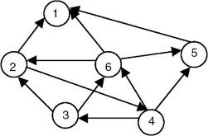

Slide 12
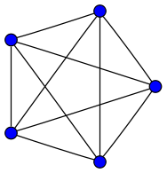
4.COMPLETE GRAPH:
A graph is said to be complete if there are edges from any vertex to all other vertices.
In such type of graph ,each vertex is adjacent to every other vertex.

Slide 13
5.CONNECTED GRAPH:
A undirected graph is said to be connected if every vertex is reachable from others by following some path.
In other words an undirected graph is said to be connected if each pair of distinct vertices (v_{i} ,v_{j} ) ɛ V has a path between them.
If this property holds true for directed graph then it is called strongly connected graph i.e. a digraph is said to be strongly connected if for every pair of distinct vertices (v_{i} ,v_{j} ) there exsist a path from v_{i} to v_{j} that connect two nodes.

Slide 14
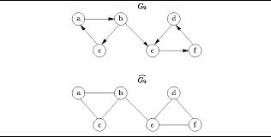
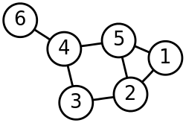
CONNECTED GRAPH
UNCONNECTED DIRECTED GRAPH

Slide 15
6.WEIGHTED GRAPH:
A graph is termed as weighted graph if all the edges in it are labelled with some weights.
A weight is the measure of the cost of using an edge to go from one vertex to another.
In an unweighted graph where the weight is not mentioned explicitly ,the cost of traversing an edge is same for all the edges.

Slide 16
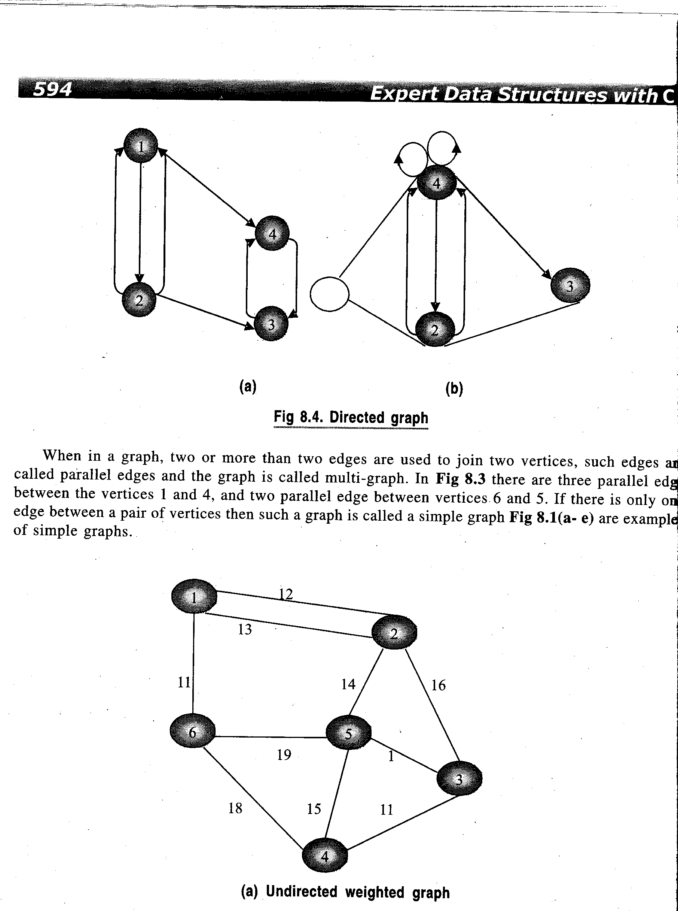

Slide 17
7.MULTIGRAPH:
It may be possible that there are two or more edges connecting the same vertices of graph.Such a graph is called multigraph.

Slide 18
REPRESENTATION OF GRAPHS

Slide 19
Representation of a graph-There are two main ways of representing a graph in memory. These are:
1)Sequential
2)Linked List

Slide 20
1.SEQUENTIAL/MATRIX REPRESENTATION
This representation can be used for both directed and undirected graph.
The graphs can be represented as matrices in sequential representation.In this representation a square matrix of order nxn is used where n is number of vertices in graph.
There are two most common matrices. These are:
Adjacency Matrix
Incidence Matrix

Slide 21
The adjacency matrix is a sequence matrix with one row and one column devoted to each vertex.
The values of the matrix are 0 or 1.
A value of 1 for row i and column j implies that edge e_{ij} exists between v_{i} and v_{j} vertices.
A value of 0 implies that there is no edge between the vertex v_{i} and v_{j}.
Thus, for a graph with v₁,v₂,v₃………..v_{n} vertices, the adjacency matrix A=[a_{ij}] of the graph G is the n x n matrix and can be defined as:

Slide 22
1 if v_{i} is adjacent to v_{j} (if there is an edge between v_{i} and v_{j})
a_{ij} =
0 if there is no edge between v_{i} and v_{j}
Such a matrix that contains entries of only 0 or 1 is called a bit matrix or Boolean matrix.
The adjacency matrix of the graph G does depend on the ordering of the nodes in G that is different ordering of the nodes may result in a different adjacency matrix.

Slide 23
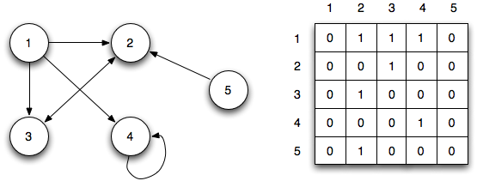

Slide 24
An adjacency matrix representing a directed graph with n vertices requires memory space of O(nxn)
Suppose G is an undirected graph. Then the adjacency matrix A of G will be a symmetric matrix i.e one in which a_{ij}=a_{ji} for every i and j.
So in some applications we need to store entries of only the upper or lower triangular portion of the adjacency matrix ,thereby reducing the memory space needed almost half i.e. O(n² /2)

Slide 25
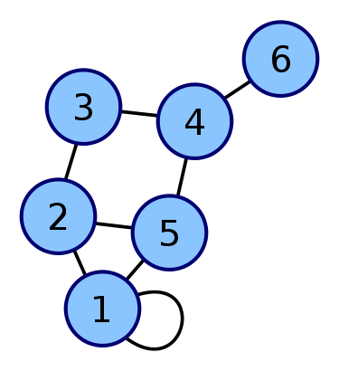
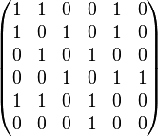
Vertices taken 1-6

Slide 26
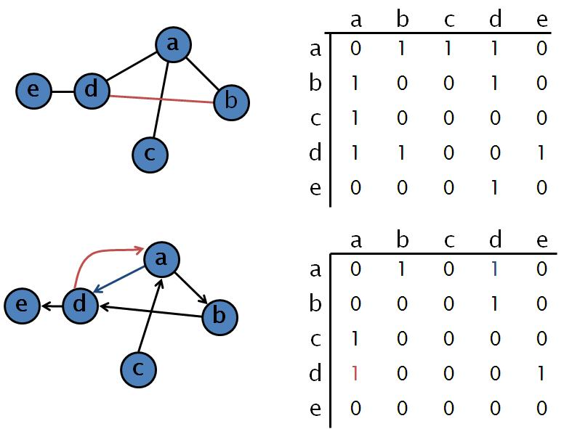
Adjacency Matrix of Directed and Undirected Graph

Slide 27
The adjacency matrix can also be used to represent weighted graph,such matrix is known as weighted adjacency matrix.
In this if an edge with the given weight exist between two vertices then we store that weight as the entry in the weighted adjacency matrix instead of 1.
However if there doesnot exist an edge between two vertices then it is represented by 0 or ∞

Slide 28
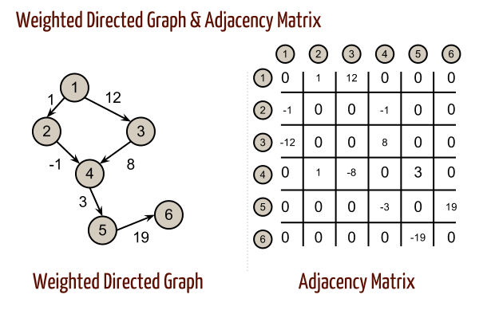

Slide 29
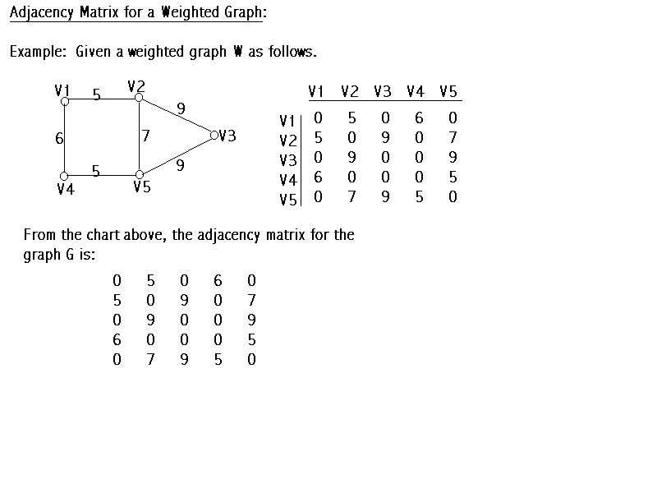

Slide 30
PROPERTIES OF ADJANCENCY MATRIX
PROPERTY 1: In the AM of an undirected graph,the degree of a vertex is the sum of the entries in a row or a column corresnponding to it.
PROPERTY 2: In the AM of the undirected graph ,the sum of all entries of the matrix is twice the number of edges in the graph.
PROPERTY 3: In AM of directed graph,the outdegree of a vertex is equal to the sum of the entries of the row corresponding to it and the indegree is sum of entries in column

Slide 31
PROPERTY 4:In AM of directed graph ,the sum of all entries of the adjacency matrix is equal to number of edges in graph.
PROPERTY 5: Suppose A be an adjacency matrix of a directed graph with n vertices
A^{n}=[a_{ij} ^{n}].
It gives the number of path of length n from vertex V_{i} to vertex v_{j}

Slide 32
Consider an Adjacency matrix A representing a graph. Then A², A³……..A^{k} of Adjacency matrix A represent the matrices with path lengths 2,3……… k respectively. In other words, if
a_{k}(i,j)= the ijth entry of matrix A^{k}
then this entry represents the number of paths of length k from node v_{i} to v_{j. .}

Slide 33
Consider the following graph:
V1
V2
V3
V5
V4

Slide 34
Adjacency matrix for the above graph is:
V1 | V2 | V3 | V4 | v5
v1
V2
V3
V4
v5
0 | 1 | 0 | 1 | 1
0 | 0 | 1 | 1 | 0
0 | 0 | 0 | 0 | 0
0 | 0 | 1 | 0 | 1
0 | 0 | 0 | 0 | 0

Slide 35
A² ⁼
A³⁼
0 | 0 | 2 | 1 | 1
0 | 0 | 1 | 0 | 1
0 | 0 | 0 | 0 | 0
0 | 0 | 0 | 0 | 0
0 | 0 | 0 | 0 | 0
0 | 0 | 1 | 0 | 1
0 | 0 | 1 | 0 | 1
0 | 0 | 0 | 0 | 0
0 | 0 | 0 | 0 | 0
0 | 0 | 0 | 0 | 0

Slide 36
0 | 0 | 0 | 0 | 0
0 | 0 | 0 | 0 | 0
0 | 0 | 0 | 0 | 0
0 | 0 | 0 | 0 | 0
0 | 0 | 0 | 0 | 0
A⁴
A⁵
0 | 0 | 0 | 0 | 0
0 | 0 | 0 | 0 | 0
0 | 0 | 0 | 0 | 0
0 | 0 | 0 | 0 | 0
0 | 0 | 0 | 0 | 0

Slide 37
Matrix A² shows that there exsist a 2 path of length two between (v1,v3) and 1 path of length 2 between (v1,v4)(v1,v5)(v2,v3)(v2,v5)
Matrix A³ shows there exsist 1 path of length 3 between (v1,v3)(v1,v5)
Matrix A⁴ and A⁵ shows no path of size 4 and 5 exsist between any of the vertices
In general ,to determine a matrix of length n(A^{n} ) ,we multiply the matrix of path of length n-1 with a matrix of length n between two vertices or not

Slide 38
PATH MATRIX
If now we represent a matrix B^{n} as
B^{n} =A+A²+A³………A^{k}
then each entry of B_{r} represent the number of paths of lengths r or less than r from node v_{i} to v_{j.}
If an entry in the ith row and jth column of matrix B^{n} is non zero then it means that vertex v_{j.} is reachable from vertex v_{i} .

Slide 39
For the graph under consideration B⁵ is
B⁵ =
Now by looking at the above matrix B⁵ ,we can determine the number of paths between any two vertices.
0 | 1 | 3 | 2 | 3
0 | 0 | 2 | 1 | 1
0 | 0 | 0 | 0 | 0
0 | 0 | 1 | 0 | 1
0 | 0 | 0 | 0 | 0

Slide 40
But inorder to determine whether a vertex is reachable from any other vertex,we only need to know the presence of a path and not the number of path between two vertices
This information regarding whether there exists a path between any two vertices or not is maintained by path matrix.
The path matrix can be calculated from the B^{n} by choosing P_{ij} using following simple rule
P_{ij} =0 if entry in the ith row and jth column of matrix B^{n} is 0
P_{ij} = 1 if the entry in ith row and jth column of matrix B^{n} is non zero

Slide 41
Path Matrix- Let G be a simple directed graph with m nodes, v₁,v₂,v₃………..v_{m}. The path matrix or reachability matrix of G is the m-square matrix P=(p_{ij}) defined as:
  1 if there is a path from v_{i} to v_{j}
  P_{ij}=
  0 Otherwise
  Suppose there is a path from v_{i} to v_{j}. Then there must be a simple
  path from v_{i} to v_{j} when v_{i} ≠ v_{j} or there must be a cycle from v_{i} to v_{j}
  when v_{i} = v_{j}. Since G has only m nodes such a simple path must be
  of length m-1 or less or such a cycle must have length m or less.

Slide 42
So ,for graph whose B⁵ is calculated,the path matrix P can be obtained by simply replacing non-zero entries of the matrix B⁵ by 1 or 0 otherwise
P=
0 | 1 | 1 | 1 | 1
0 | 0 | 1 | 1 | 1
0 | 0 | 0 | 0 | 0
0 | 0 | 1 | 0 | 1
0 | 0 | 0 | 0 | 0

Slide 43
WARSHALL ALGORITHM
A better and relatively simple method to compute the path matrix of a given graph is using warshall algorithm.
Warshall algorithm determines whether for directed graph G=(V,E) with vertex set V ={1,2……..n},there exists a path in G from i to j for all vertex pairs(i,j)ɛ V.
This algorithm tests the reachibility of all pair of vertices in a graph

Slide 44
The basic idea behind this algorithm is that path vertex i to vertex j exists(i.e. P[i,j]=1) if either of two conditions hold true:
There exists a direct path from vertex I to vertex j.
There exists an indirect path from vertex i to vertex j through one or more intermediate vertices.
In order to compute the path for any pair of vertices of a graph G using warshall algorithm we first need to compute sequence of nxn boolean matrices.

Slide 45
One might remember that matrix P₀ contains direct edges with no intermediates so P₀ =A,adjacency matrix of G.
Warshall observed that P_{k} [i,j]=1 if and only if there is a simple path from vertex i to vertex j by going through vertex i to vertex k and a path from vertex k to vertex j,each involving intermediate vertices in the set{1,2……(k-1)}
With this information,the entry (i,j) of the boolean matrix is obtained by looking at entries in the matrix P_{k} using condition
P_{k} [i,j]=P_{k-1} [i,j] V(P_{k-1} [i,k] Ʌ P_{k-1} [k,j])

Slide 46
Consider the graph G2 and its corresponding adj matrix:
2
5
1
0 | 1 | 1 | 0 | 0
0 | 0 | 0 | 1 | 0
0 | 0 | 0 | 1 | 0
1 | 0 | 0 | 0 | 0
0 | 0 | 0 | 1 | 0
3
4

Slide 47
In order to find path between any two pair of vertices ,we need to compute boolean matrices P_{0,}P_{1,…………..}P₅
P₀ =A i.e P₀ =
0 | 1 | 1 | 0 | 0
0 | 0 | 0 | 1 | 0
0 | 0 | 0 | 1 | 0
1 | 0 | 0 | 0 | 0
0 | 0 | 0 | 1 | 0

Slide 48
While computing P₁ we have to find new paths between pair of vertices with vertex 1 as intermediate vertex.
P₁ =
This shows that there exist path between vertex (4,2) and (4,3) with vertex 1 as intermediate[4,1,2] and [4,1,3].
0 | 1 | 1 | 0 | 0
0 | 0 | 0 | 1 | 0
0 | 0 | 0 | 1 | 0
1 | 1 | 1 | 0 | 0
0 | 0 | 0 | 1 | 0

Slide 49
While computing P₂ we have to find new paths between pair of vertices with vertex 1 or 2 or both as intermediate vertex.
P₂ =
0 | 1 | 1 | 1 | 0
0 | 0 | 0 | 1 | 0
0 | 0 | 0 | 1 | 0
1 | 1 | 1 | 1 | 0
0 | 0 | 0 | 1 | 0

Slide 50
Similarly P₃ , P₄ and P₅ can be calculated
P₃ =
0 | 1 | 1 | 1 | 0
0 | 0 | 0 | 1 | 0
0 | 0 | 0 | 1 | 0
0 | 0 | 0 | 1 | 0
0 | 0 | 0 | 1 | 0

Slide 51
P₄ =
1 | 1 | 1 | 1 | 0
1 | 1 | 1 | 1 | 0
1 | 1 | 1 | 1 | 0
1 | 1 | 1 | 1 | 0
1 | 1 | 1 | 1 | 0

Slide 52
While computing P₅ using P_{4 ,} as there is no new path with vertex 5 as the intermedite vertex so P₅₌ P_{4.}
P₅ =
So the above matrix is the actual path matrix we were looking for which tells whether there exsist path between two vertices or not.
1 | 1 | 1 | 1 | 0
1 | 1 | 1 | 1 | 0
1 | 1 | 1 | 1 | 0
1 | 1 | 1 | 1 | 0
1 | 1 | 1 | 1 | 0

Slide 53
Warshall Algorithm
WARSHALL(A):Given an adjacency matrix A of order n by n for the graph G with n vertices labelled as 1,2………n. The algorithm generates the path matrix P of order n by n.

Slide 54
[initialize P with A i.e. computing P₀ ]
Repeat step 2 for I=1,2,……N
Repeat for J=1,2,………..N
P[I,J]←A[I,J]
[End of step 2 loop]
[End of step 1 loop]
[Computing P_{1 ,} P_{2,……………….} and finally P_{N} i.e. P]
3. Repeat steps 4,5 for K=1,2……..N
4. Repeat steps 5 for I=1,2……….N
5. Repeat for J=1,2…………..N
P[I,J]←P[I,J] V (P[I,K] AND P[K,J])
[End of step 5 loop]
[End of step 4 loop]
[End of step 3 loop]
6. Return

Slide 55
LINKED REPRESENTATION OF GRAPH
The sequential representation of the graph in memory i.e the representation of graph by adjacency matrix has a number of major drawbacks
It may be difficult to insert and delete nodes in Graph. This is because the size of array may need to be changed and the nodes may need to reordered which can lead to many changes in the matrix.
Also if the number of edges are very less, then, the matrix will be sparse and there will be wastage of memory.

Slide 56
In linked representation of a graph ,two linked lists a vertex list and adjacency list are maintained.
The vertex list is a singly linked list mainaining all the vertices in the list irrespective of any order.
From each node of this vertex list another linked list known as adjancency list eminates that maintains all the vertices adjancent to the vertex stores in source node irrespective of any order

Slide 57
Each node of the vertex list contain of three parts:
The first part VERT_INFO that stores the vertex name.
The second part NEXTLINK that points to the next node in the vertex list.
The third part ADJ_LINK that points to the first node of its adjaceny list.
A node of the adjacency list consists of two parts:
The first part LINK_VERT that points to the node of the vertex list which is adjancent to it.
The second part LINK that points to the next node in the same adjacency list.

Slide 58
A D
E
B C
Node | Adjacency List
A B C D E | B,C,D C C,E C
www.csemcq.com

Slide 59
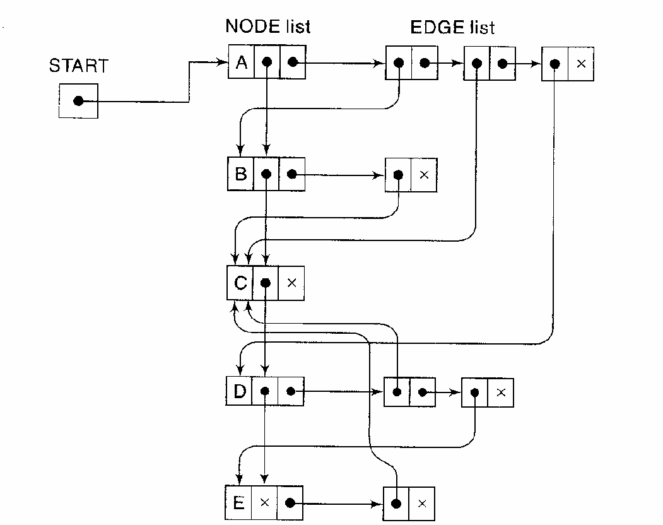

Slide 60
FLOYD’S ALGORITHM
This algorithm generates a matrix COST of order n by n that maintains the cost of the shortest paths between all pair of vertices.
Each row of this matrix corresponds to a source vertex and each column corresponds to a destination vertex.
In this we maintain two matrix,one is cost matrix and other is Predecessor matrix and calculated on based on the following formula

Slide 61
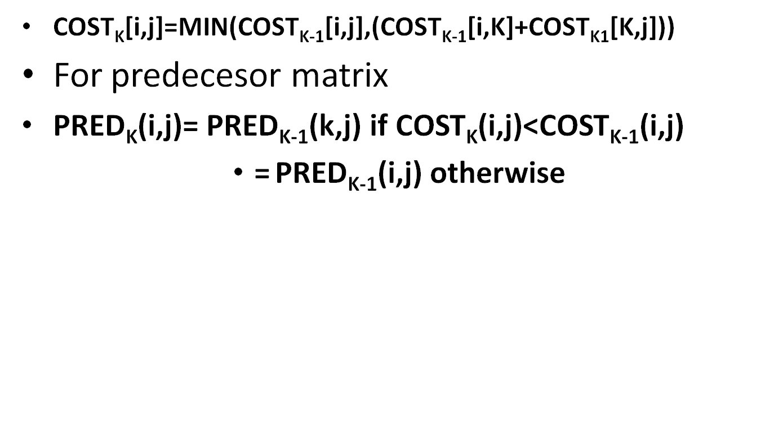

Slide 62
FLOYD WARSHALL
FLOYD(W,N): Given a graph G which is represented using weighted adjacency matrix W of order N by N where N are the total number of vertices labeled as 1,2….N. This algo computes and return two matrices COST and PRED each of order N by N. The matrix COST stores the cost of the shortest paths for all pair of vertices . The matrix PRED maintains information about vertices that constitute the shortest path for all pair of vertices.

Slide 63
Repeat step 2 for I=1,2,…….N
Repeat for J=1,2……….N
If W[I,J]= ∞ then [No edge exist]
a) COST[I,J]←∞
b) PRED[I,J]←0 [No immediate predecessor]
Else [Edge exists]
a)COST[I,J]←W[I,J]
b) PRED[I,J]←I [Predecessor of vertex J is I]
[End of Structure]
[End of Step 2 Loop]
[End of Step 1 loop]
[Remaining steps compute shortest paths for all pair of vertices]
3. Repeat steps 4 and 5 for K=1,2,……………..N
4. Repeat Step 5 for I=1,2,………..,N

Slide 64
5. Repeat step for J=1,2……..N
If (COST[I,K]+ COST[K,J] <COST[I,J] then
a) COST[I,J]←COST[I,K]+COST[K,J]
b) PRED [I,J]←PRED[K,J]
[End of If structure]
[End of step 5 loop]
[End of step 4 loop]
[End of step 3 loop]
6. Return (COST,PRED)

Slide 65
OPERATIONS ON GRAPH

Slide 66
OPERATIONS ON GRAPH
The basic operations that can be performed on graph are:
Insertion
Deletion
Traversing

Slide 67
TRAVERSING
Traversing is the key operations performed on a graph.
Traversing a graph involves visiting all the vertices exactly once.
Two methods are used:
BFS(Breadth First Search)
DFS(Depth First Search)

Slide 68
BREADTH FIRST SEARCH
The basic idea behind BFS is that after visiting a vertex N , we visit all the vertices which are adjacent (in the immediate neighborhood) to vertex N before visiting any neighborhood of neighbors of B
BFS approach is similar to level order traversal of tree in which entire level is explored before moving on to the next level.
But unlike tree traversal where root node is always the start node ,in graph traversal can start from any vertex.

Slide 69
Before discussing the algorithm for BFS traversal,we need to consider two issues.
(i) if a vertex is adjacent to two or more vertices then we must ensure that a vertex once visited must not be revisited again.to resolve this issue ,we need to use a variable STATUS associated with every vertex that keep track whether a vertex is visited or not.
STATUS(N) can have one of the three values:
Not Visited : Vertex N not encountered yet during traversal
Waiting: Vertex N currently in waiting line waiting to be visited.
Visited: Vertex N is visited i.e. its processing is completed.

Slide 70
(ii) the second issue is choice of data structure for waiting list that stores those vertices which are still waiting to be processed
In BFS we choose a queue data structure that has FIFO property so as to maintain the order in which vertices arrive.

Slide 71
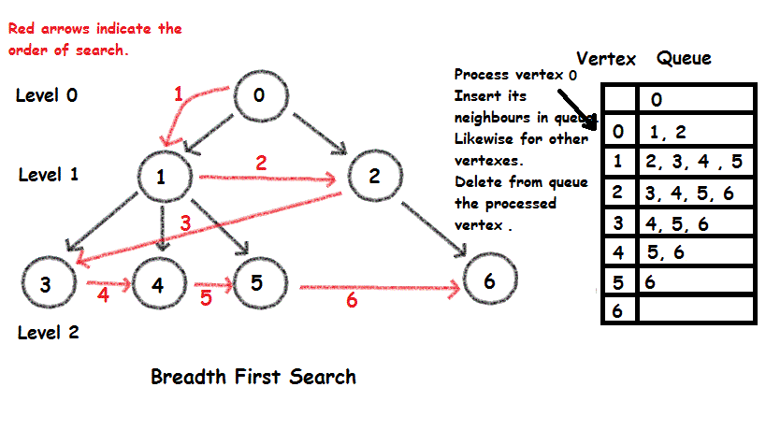

Slide 72
BFS_TRAVERSAL(GRAPH G) –The algorithm traverse each vertex of graph G starting at vertex A using BFS traversal
1.All the vertices of G are intially in “Not Visited” state
2.Insert the starting vertex A into the queue and change its state to “Waiting”
3.Repeat step 4 to 6 while QUEUE is not empty
4. [store vertex at front of QUEUE into variable W]
W←vertex at the front of QUEUE
5.Remove W from QUEUE and change its status to “Visited”
6.For each neighbour N of W in G do
If(vertex N is “not visited” ) then
Insert vertex N into QUEUE and change its status to “Waiting”
[end of if structure][end of for loop][end of step 3 loop]
7.Return

Slide 73
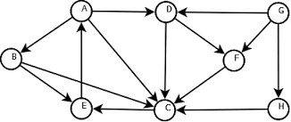
PRACTICE

Slide 74
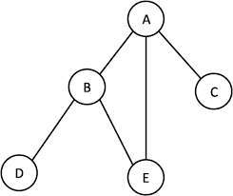

Slide 75
DEPTH FIRST SEARCH(DFS)
The basic idea behind DFS is to traverse vertices of the graph as deep as possible before looking at any other adjacent vertices in a graph.
In DFS travsal stack data structure is more suitable.
Like BFS ,the STATUS variable is also used to maintain the status of every vertex.

Slide 76
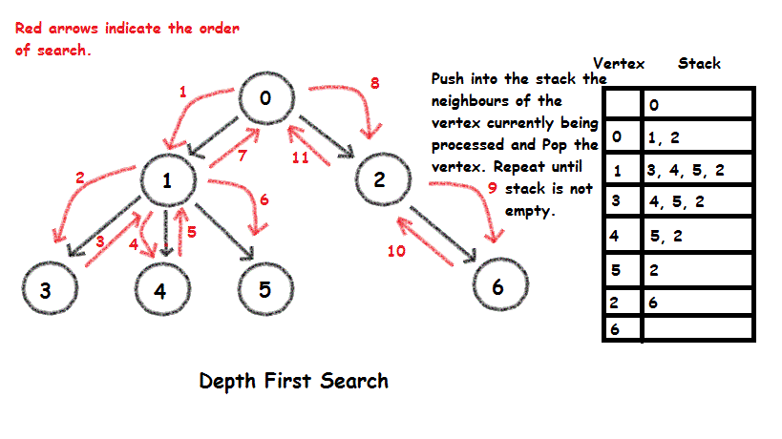

Slide 77
DFS_TRAVERSAL(GRAPH G)-The algorithm traverses each vertex of the graph G starting at vertex A using DFS traversal.
1.All the vertices of G are intially in the “Not Visited” state
2.Push the starting vertex A onto the stack and change the status to “waiting” state.
3.Repeat steps 4 to 6 while STACK is not empty
4.[store the vertex at the TOP of the STACK into variable W]
5.Pop W from the STACK and change its status to “Visited”
6.for each neighbour N of W in G do
if(vertex N is “Not Visited”) then
Insert vertex N onto the STACK and changes its status to “Waiting”
[end of if strucutre][end of for loop][end of step 3 loop]
7.Return

Slide 78
PRACTICE

